Slide 1
IC100 CNC Machine
Dr. Purnendu Das (Presenter)
Dr Jose Immanuel R. (Owner)
Assistant Professor
Department of Mechanical Engineering
Indian Institute of Technology Bhilai

Slide 2
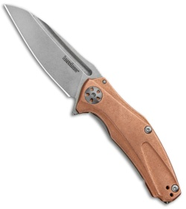
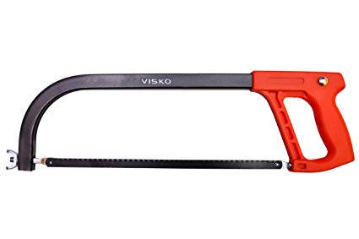
Principle of cutting

Slide 3
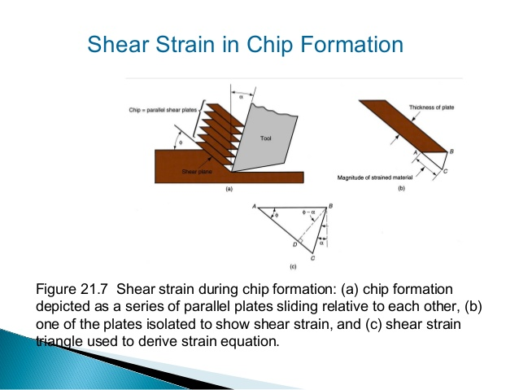
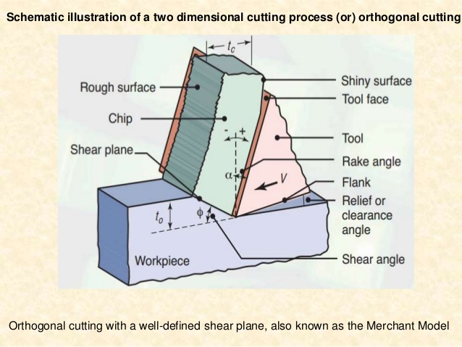
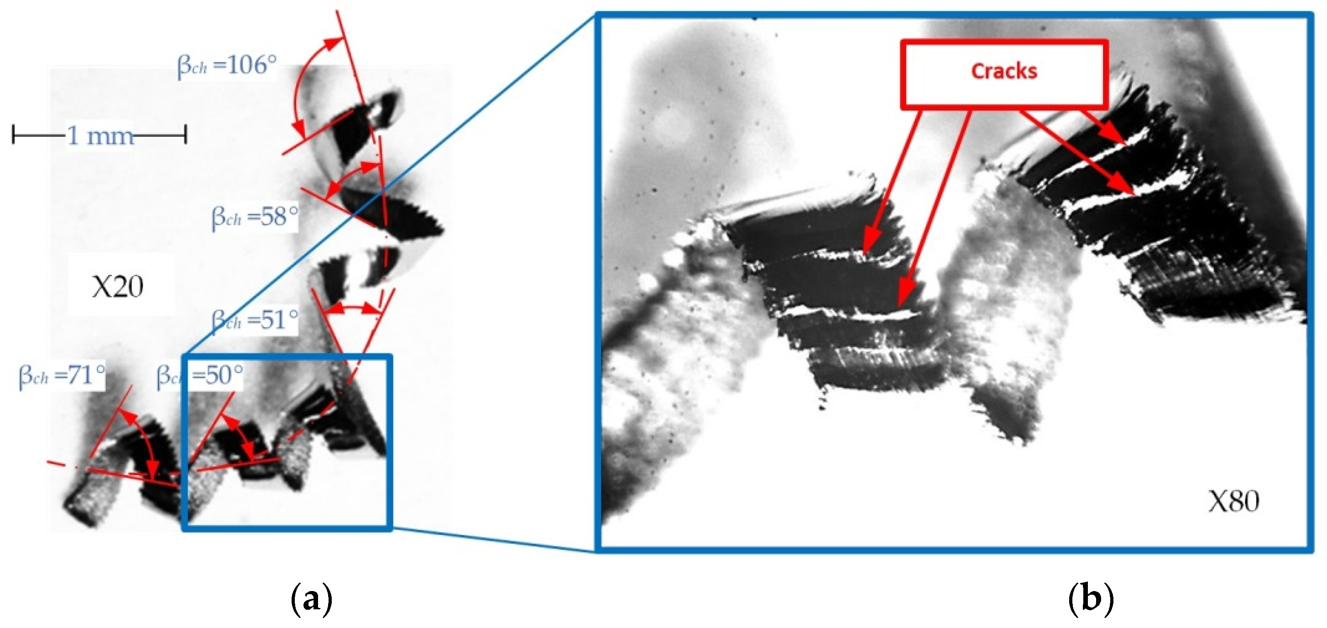
Principle of cutting

Slide 4
Machining Centers - A bit of history
1949
US Air Force asks MIT to develop a "numerically controlled" machine.
1952
Prototype NC machine demonstrated (punched tape input)
1980-
CNC machines (computer used to link directly to controller)
1990-
DNC: external computer “drip feeds” control programmer to machine tool controller

Slide 5
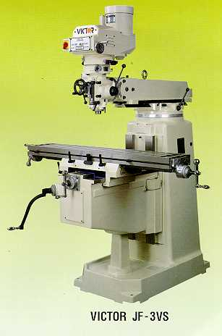
Conventional milling machines
Vertical milling machine

Slide 6
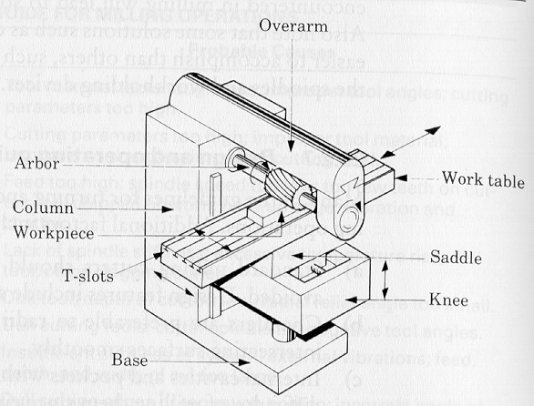
Conventional milling machines
Horizontal Milling machine architecture
How does the table move along X- Y- and Z- axes ?

Slide 7
Conventional milling machines

Slide 8
Introduction to CNC
Numerical control (NC) is the automation of machine tools that are operated by precisely programmed commands encoded on a storage medium, as opposed to controlled manually.
Most NC today is computer numerical control (CNC), in which computers play an integral part of the control.
In modern CNC systems, end-to-end component design is highly automated using computer-aided design (CAD) and computer-aided manufacturing (CAM) programs.

Slide 9
Advantages of CNC
CNC machines can be used continuously
Batch production with high accuracy
Can be updated by improving the software
Training in the use of CNCs is available through the use of ‘virtual software’.
Intricate detail machining
No need to make a prototype or a model
One person can supervise many CNC machines simultaneously – Economical and time saving

Slide 10
Disadvantages
Expensive than manually operated machines
CNC machine operator only needs basic training and skills, enough to supervise several machines. In years gone by, engineers needed years of training to operate centre lathes, milling machines and other manually operated machines. This means many of the old skills are been lost.
Investment in CNC machines can lead to unemployment

Slide 11
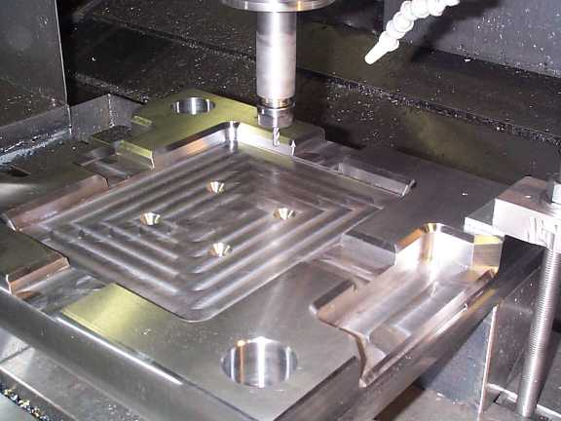
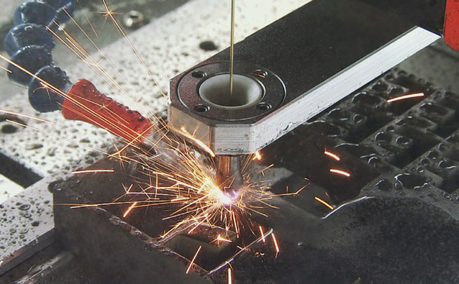
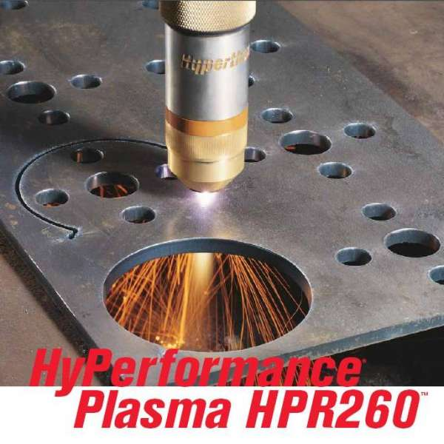
Operations in CNC
CNC Milling
CNC Plasma Cutter
CNC Electric Discharge Machining

Slide 12
Other CNC Operations
CNC Water Jet Cutter
Drilling
Sheet metal works (Turret punch)
Wire bending machines
Surface grinders
Cylindrical grinders

Slide 13
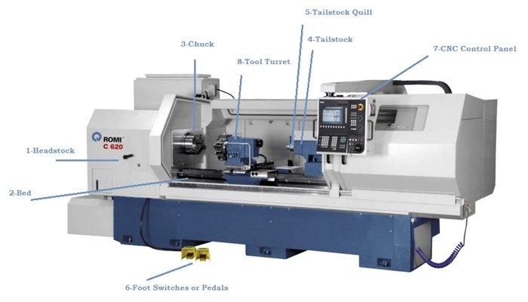
Some principle components

Slide 14
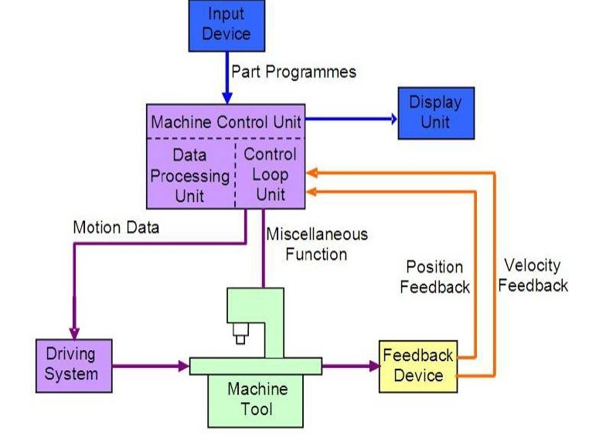
Elements of CNC Machine
SIX major elements:
Input Device
Machine Control Unit
Machine Tool
Driving System
Feedback Devices
Display Unit

Slide 15
Types
Based on Motion Type:
Point-to-Point or Continuous path
Based on Control Loops:
Open loop or Closed loop
Based on Power Supply:
Electric or Hydraulic or Pneumatic
Based on Positioning System
Incremental or Absolute

Slide 16
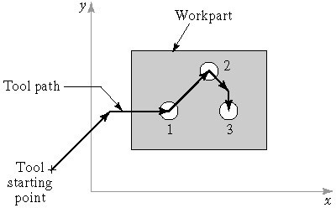
Motion Control Systems
1. Point-To-Point Control: CNC Drilling of Three Holes in Flat Plate
System moves to a location and performs an operation at that location (e.g., drilling)
Also applicable in robotics

Slide 17
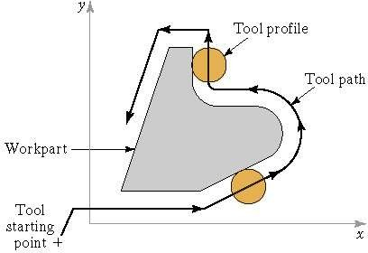
Motion Control Systems
2. Continuous Path Control in CNC Profile Milling of Part Outline
System performs an operation during movement (e.g., milling and turning) - Contouring

Slide 18
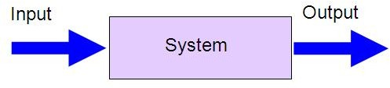
Open Loop Systems
Open loop systems have no access to the real time data about the performance of the system and therefore no immediate corrective action can be taken in case of system disturbance.

Slide 19
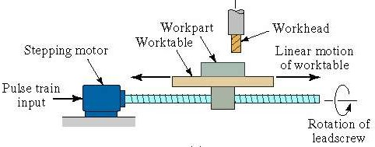
Open loop system – An example

Slide 20
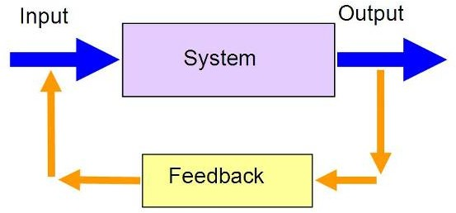
Close Loop Systems
In a close loop system, feed back devices closely monitor the output and any disturbance will be corrected in the first instance. Therefore high system accuracy is achievable.

Slide 21
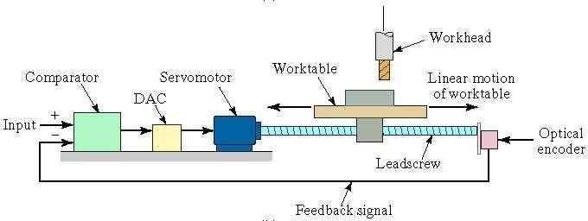
Close loop system – An example

Slide 22
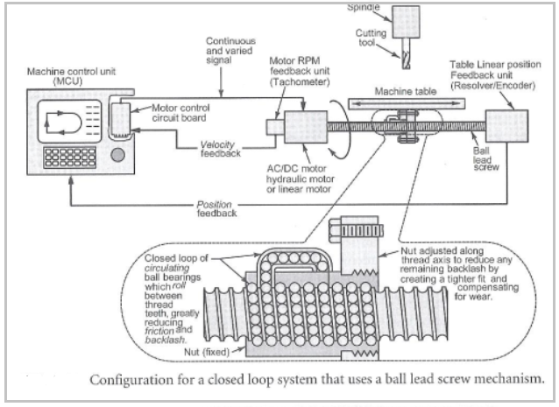
Ball Lead Screws
Ball lead screw is the heart of the drive system.
Advantages of ball lead screw are:
Precise position and repeatability
High Speed capability
Less Wear
Longer life
PITCH Vs LEAD

Slide 23
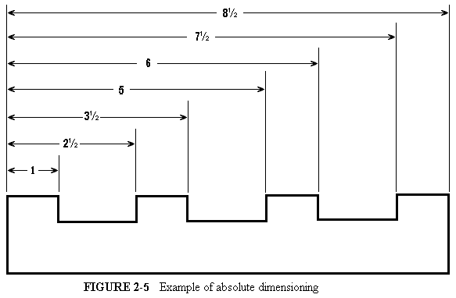
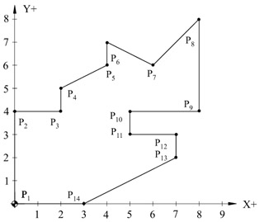
Absolute and relative dimensioning

Slide 24
CNC Programming Basics
CNC instructions are called part program commands.
When running, a part program is interpreted one command line at a time until all lines are completed.
Commands, which are also referred to as blocks, are made up of words which each begin with a letter address and end with a numerical value.

Slide 25
CNC programming – Things to know
Programming consists of a series
of instructions in form of letter codes
Preparatory Codes:
G codes- Initial machining setup and
establishing operating conditions
N codes- specify program line number
to executed by the MCU
Axis Codes: X,Y,Z
Used to specify motion of the slide along
X, Y, Z direction
Feed and Speed Codes: F and S
Specify feed and spindle speed
Tool codes: T – specify tool number
Miscellaneous codes – M codes
For coolant control and other activities
Coordinate System
Units, incremental or absolute positioning
Coordinates: X,Y,Z, RX,RY,RZ
Feed rate and spindle speed
Coolant Control: On/Off, Flood, Mist
Tool Control: Tool and tool parameters

Slide 26
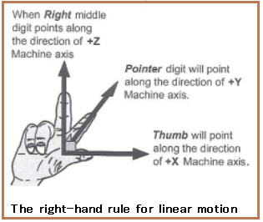
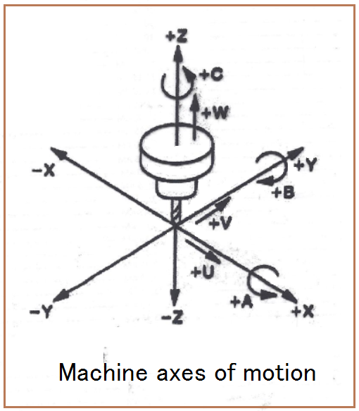
Axes of CNC Machine Tool
Notes:
A axis of motion is defined as an axis where relative motion between cutting tool and workpiece occurs.
The primary axes of motion are referred to as the X, Y, and Z axes and form the machine tool XYZ coordinate system.
In CNC machine tool, each axis of motion is equipped with a driving device to replace the handwheel of the conventional machine tool.
Figure shows the coordinate system and the axes of motion of a typical machine tool.
Conventionally machine tools are designated by the number of axes of motion they can provide to control the tool position and orientation.
In these CNC machine tools, the tool is controlled along the three axes (X, Y, and Z) simultaneously, but the tool orientation doesn’t change with the tool motion .

Slide 27
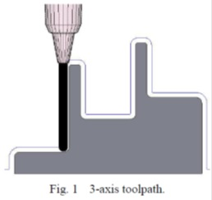
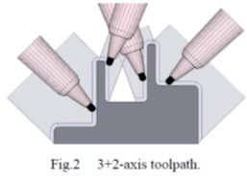
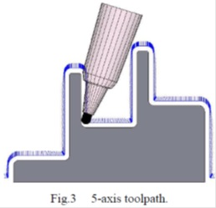
From 3-axis to 5-axis machining
dozens of views need to be defined
more tool movements
programming is quite difficult
sum of all views does not cover the whole geometry
overlapping views lead to surface quality problems
More number of lead-in and out
movements
Not sufficient for the complete finishing process for very deep part and having narrow cavities
Results in a bad surface quality and long machining times in Case of harder material

Slide 28
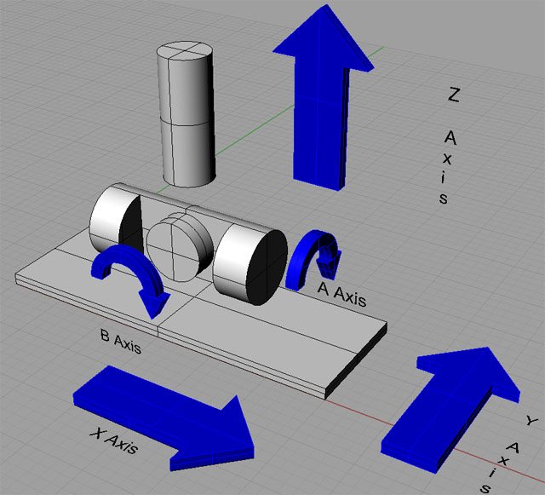
Five Axis CNC

Slide 29
Application
complex three dimensional profiles
for impellers, turbine blades, and plastic mold tools

Slide 30
ADVANTAGES OF 5 AXIS CNC
to machine complex shapes in a single setup
reduces the machinist setup time and increases production rates
By eliminating multiple set-ups, time and errors are reduced
the feature-to-features accuracy is improved because the same zero or datum reference frame is used throughout the manufacturing process
since simultaneous movement is allowed along the X and Y axis, shorter and more rigid tools may be used
higher spindle/cutting tool speeds may be achieved while reducing the load on the cutting tool
Shorter and thicker cutters also reduce vibration when machining deep pockets or contoured features with three-axis machines.

Slide 31
Programming the machines – G code
Each line of program -> Block
Sequence and format of words:
N3 G2 X+1.4 Y+1.4 Z+1.4 I1.4 J1.4 K1.4 F3.2 S4 T4 M2
destination coordinates
sequence no
dist to center of circle
tool
spindle speed
feed rate
preparatory function
miscellaneous function

Slide 32
Programming Key Letters
O - Program number (Used for program identification)
N - Sequence number (Used for line identification)
G - Preparatory function
X - X axis designation
Y - Y axis designation
Z - Z axis designation
R - Radius designation
F – Feed rate designation
S - Spindle speed designation
H - Tool length offset designation
D - Tool radius offset designation
T - Tool Designation
M - Miscellaneous function

Slide 33
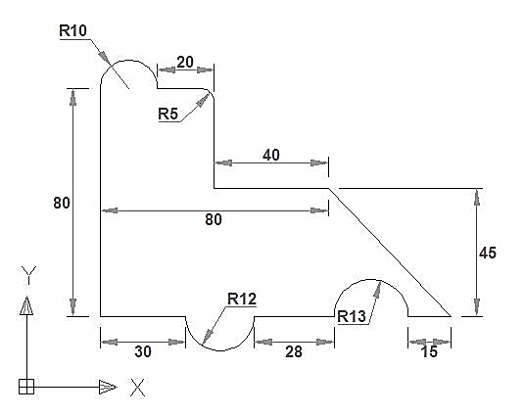
Some essential G-codes
G00 Rapid traverse
G01 Linear interpolation
G02 Circular interpolation CW
G03 Circular interpolation CCW
G20 Imperial unit
G21 Metric unit
G90 Absolute system
G91 Incremental system
G94 Feed per minute
G95 Feed per revolution
Some essential M-codes
M00 Program Stop
M03 Spindle on CW
M04 Spindle on CCW
M05 Spindle stop
M06 ATC
M08/M09 Coolant on/off
M10/M11 Vice Open/close
M30 Program stop and rewind
M98 Sub-program call
M99 Sub-program end and return

Slide 34
Example
Feed: 30 mm/min
Speed: 5000 rpm

Slide 35
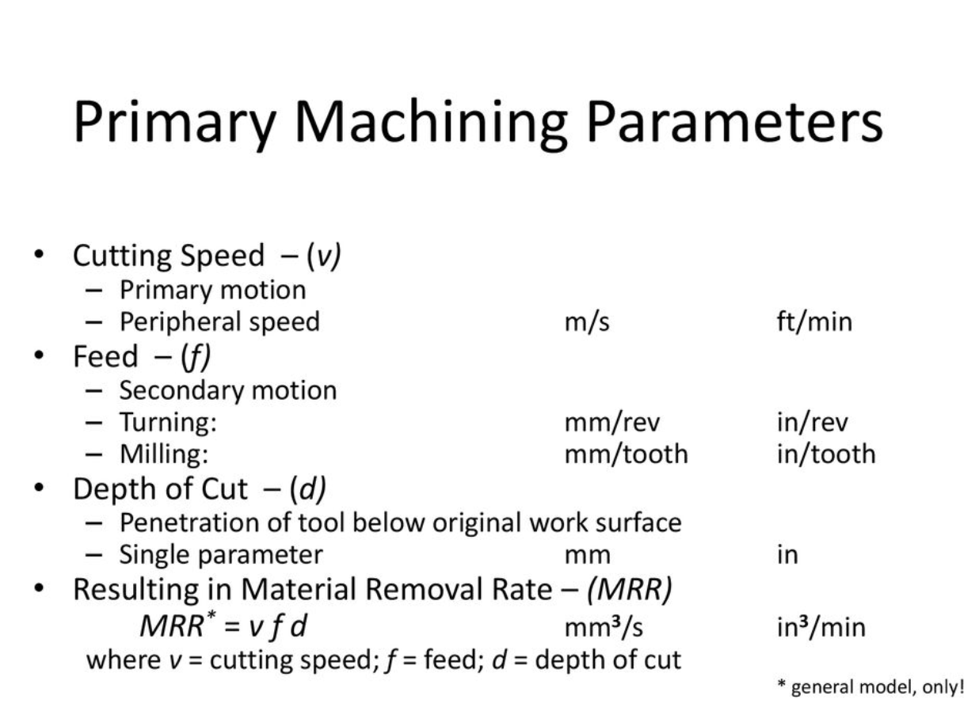

Slide 36
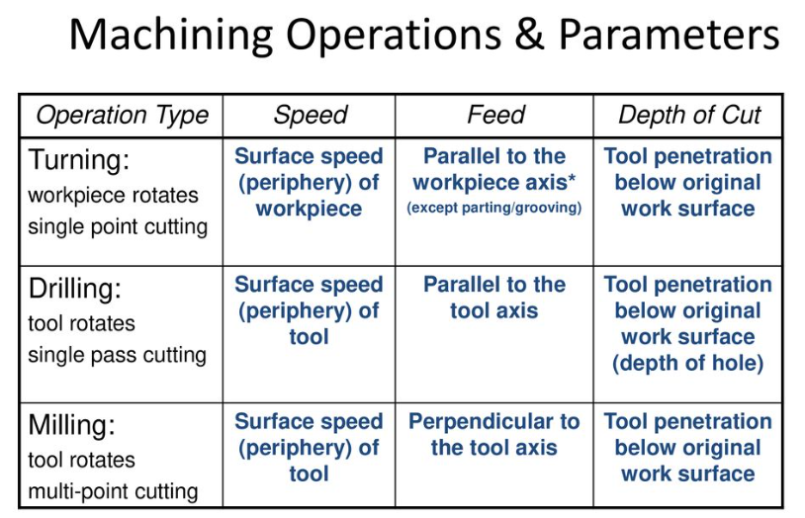

Slide 37
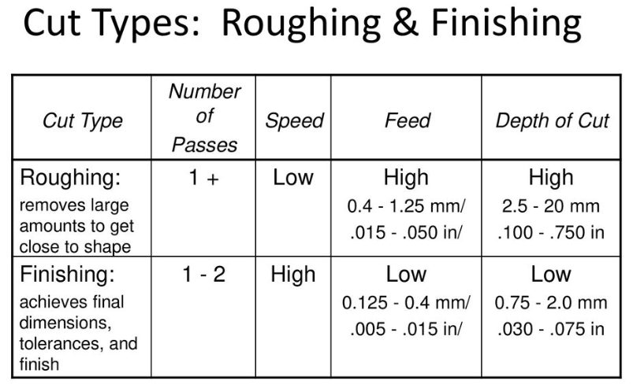

Slide 38
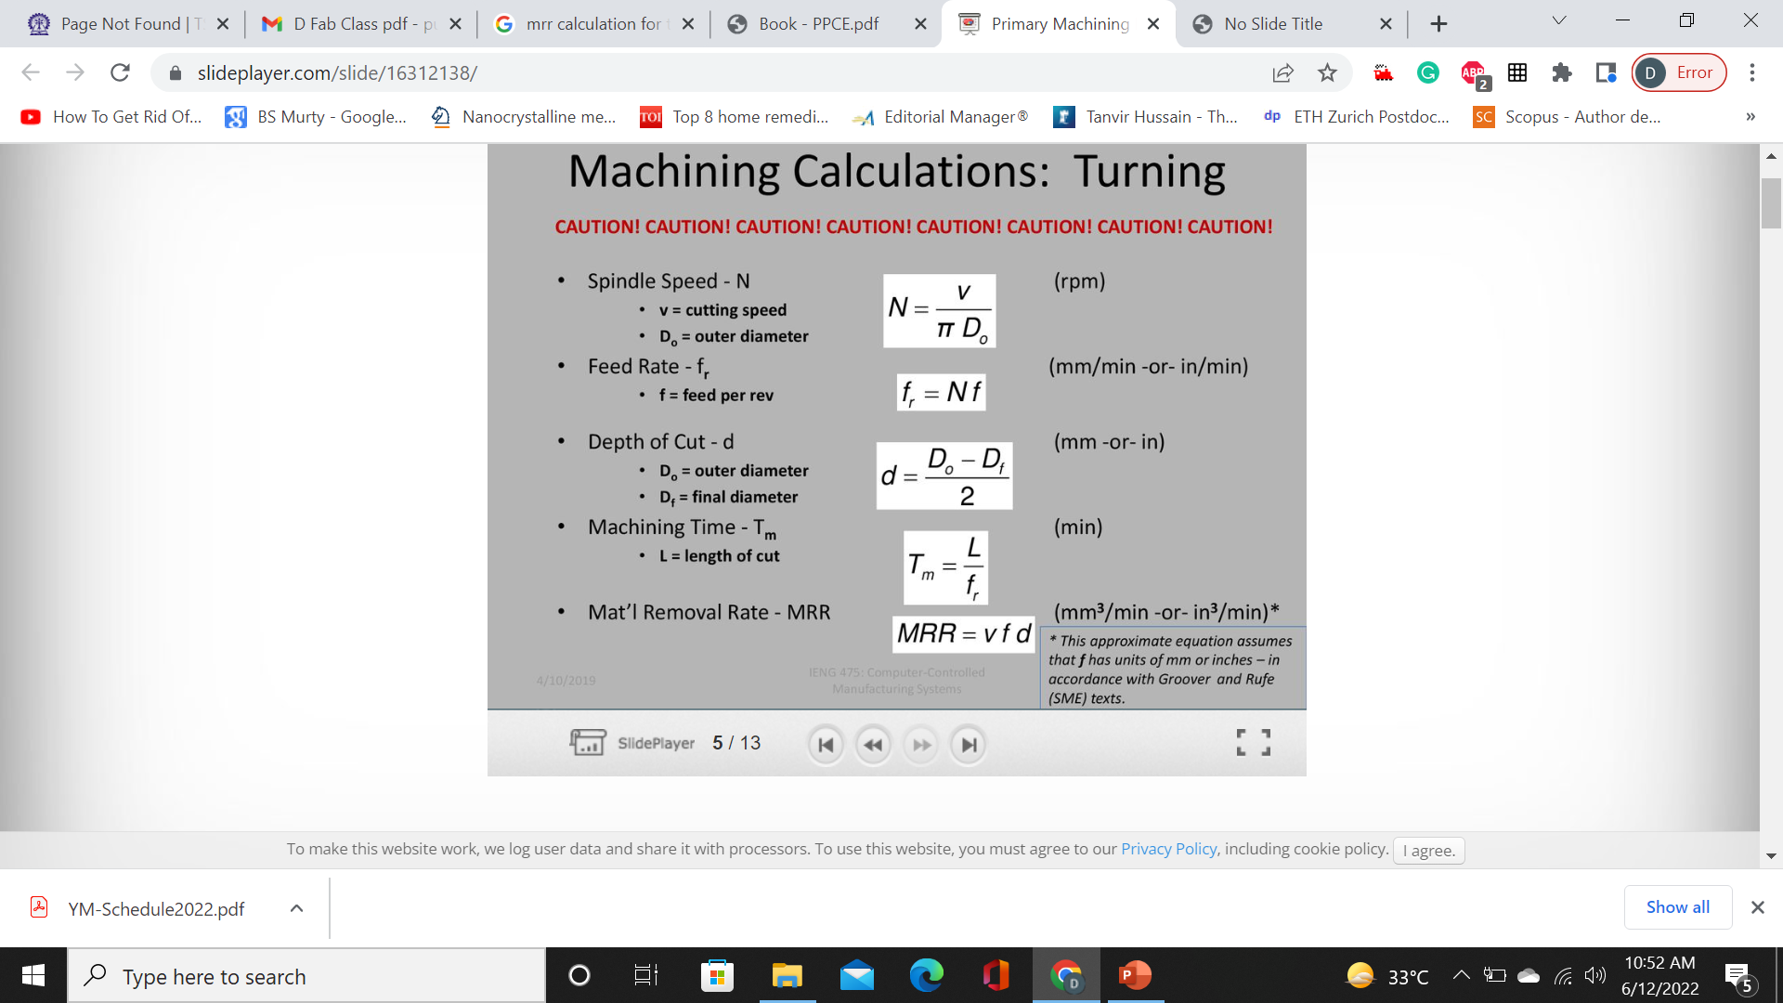

Slide 39
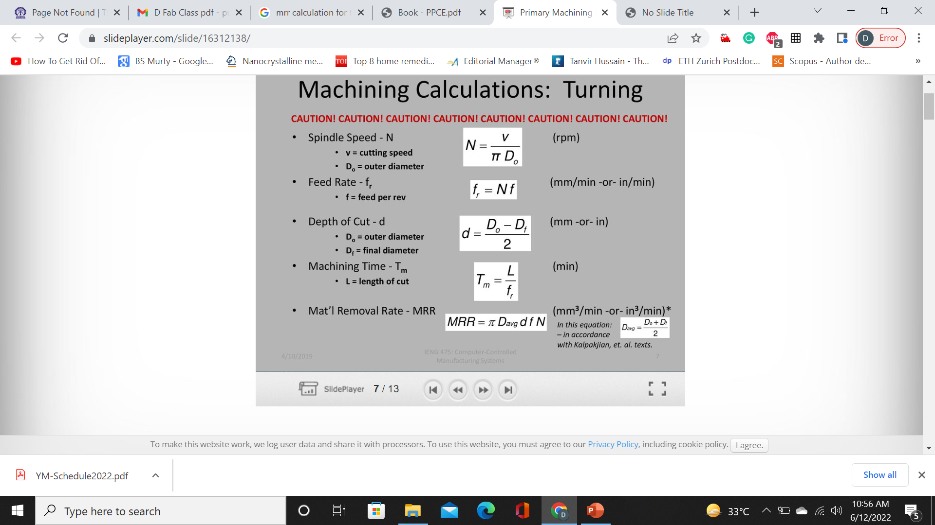
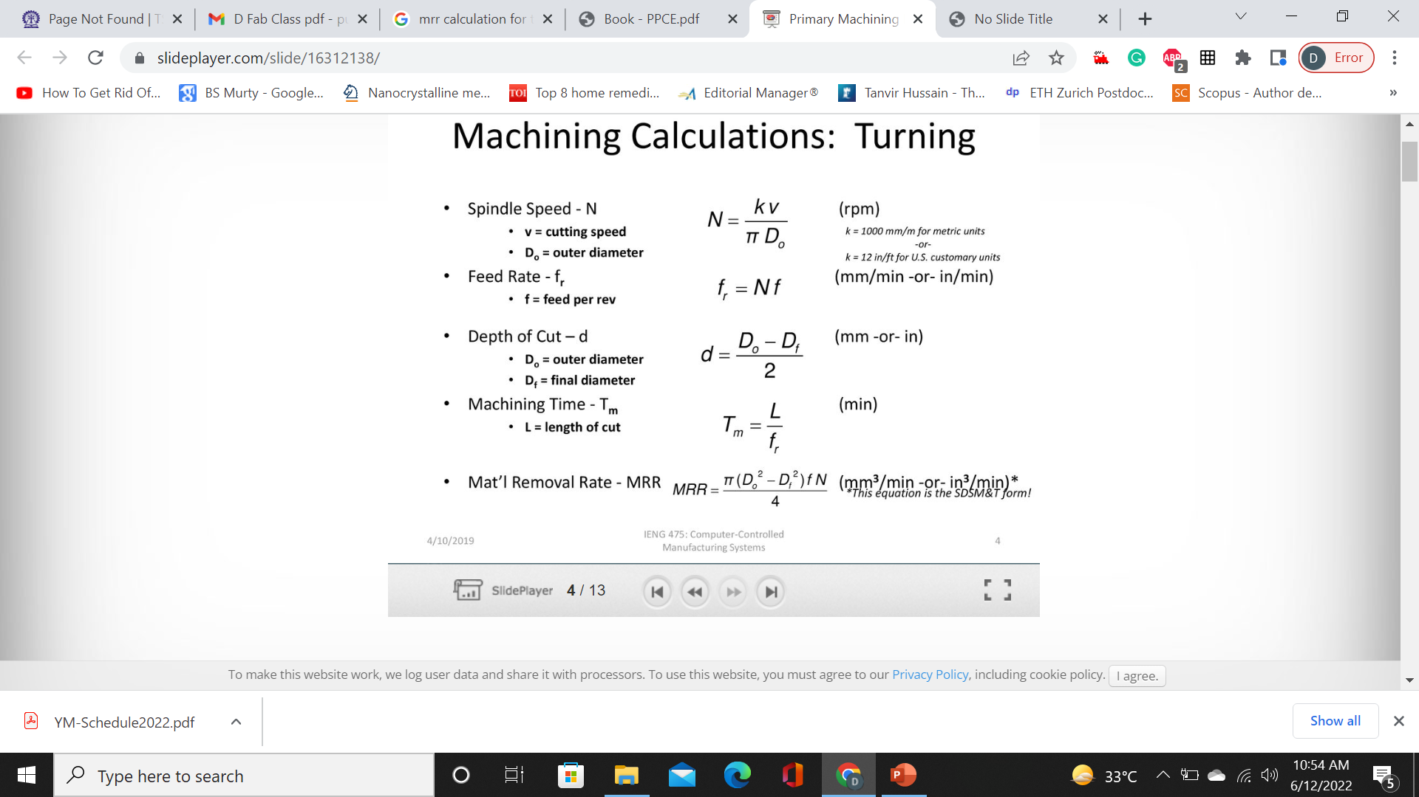


Slide 40


Slide 41
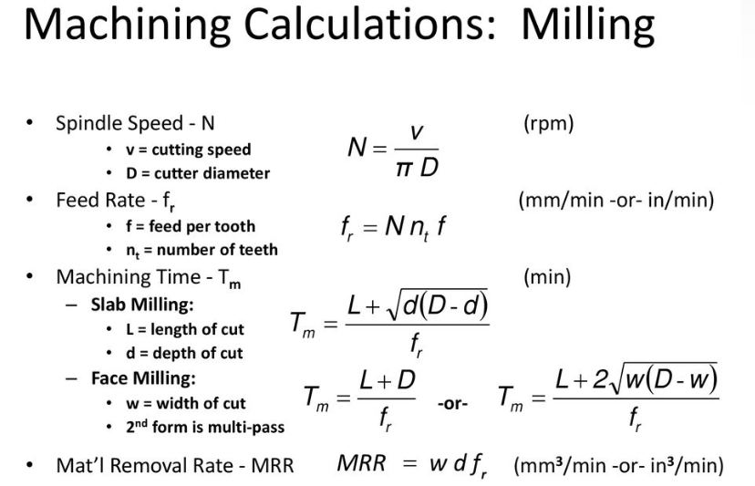

Slide 42
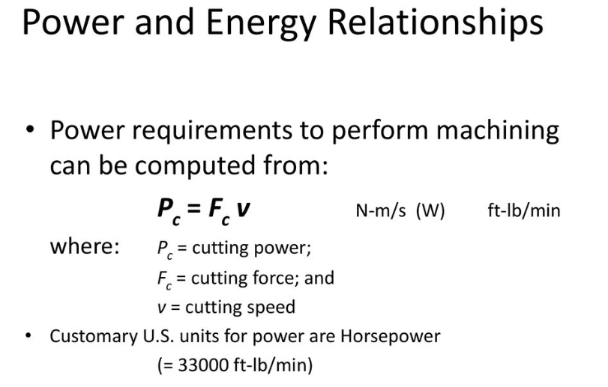

Slide 43
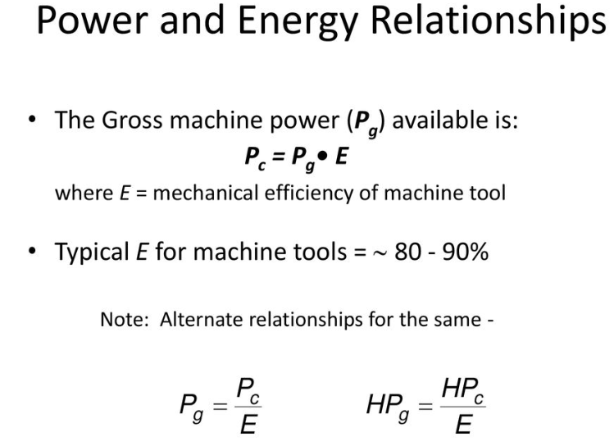

Slide 44
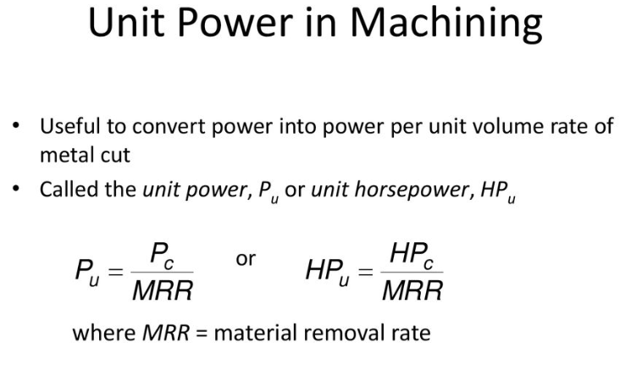

Slide 45
